Slide 1
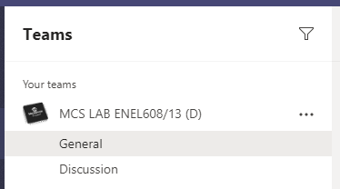

Lab Hand In and Grades
Navigate to your lab’s Teams group
Select “Assignments” to view the lab problems and submit your lab report
Select “Grades” to see all your work marked from Lab 5 onwards

Slide 2
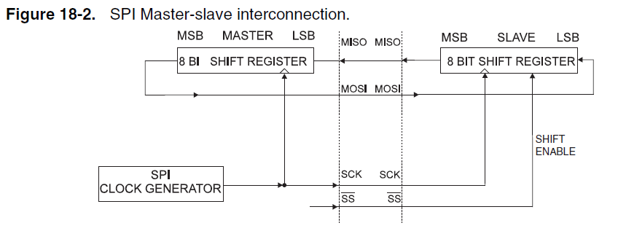
Serial Peripheral Interface
Full Duplex – Transmit and receive data at the same time
Synchronous – Shared clock between the Master and Slave
The Clock signal needed to send or receive data is generated by the Microcontroller
  It only generates this clock signal when the Microcontroller sends data
  This is where you might see “garbage” being sent when we read data from an SPI device
There are two registers that need to be set in the setup() to use the SPI
  SPCR
  SPSR
Microchip AT90USB1287 Datasheet

Slide 3
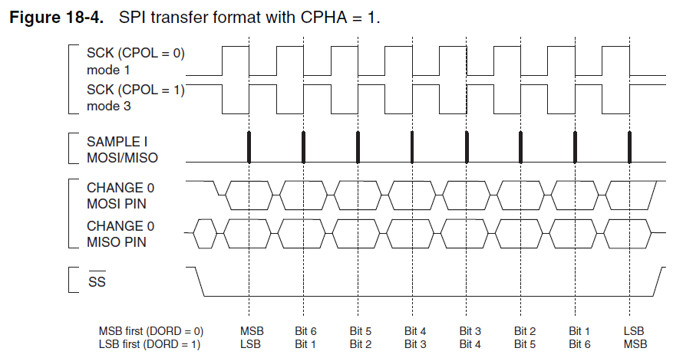
SPI – Data Packet
Clock Signal generated by μC, Tx over SCK line
Sample Signal we want to send (0xFF)
Slave Select (SS) line is pulled down
Notice: DORD changes the order of Bits sent
Microchip AT90USB1287 Datasheet
Notes:
SS Line is pulled down, so that if two devices try to access the same SPI device at the same time, we don’t cause a malfunction. If we pulled devices high, having voltage supplied from two masters could send a dangerous amount of current to the slave! Some devices may require the Slave Select to drive HIGH however​

Slide 4
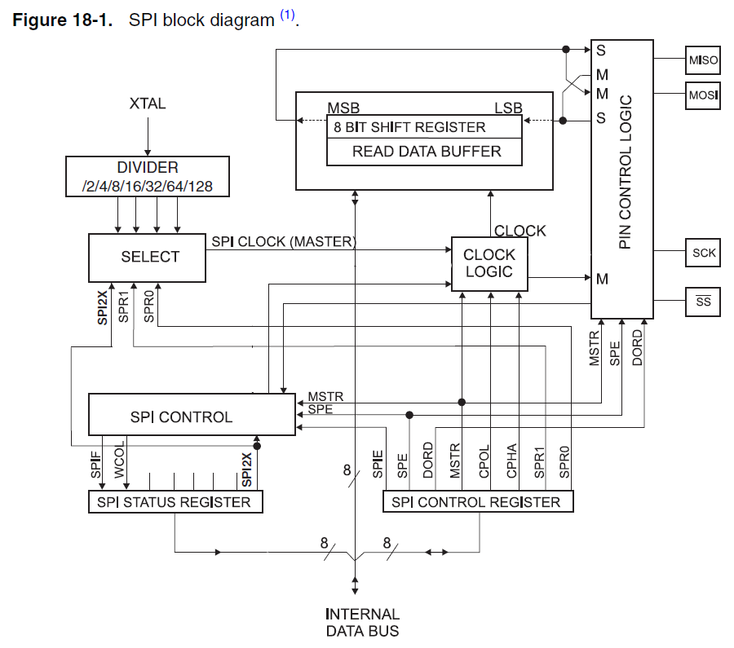
SPI – Block Diagram
The Clock
  Generated by the f_{osc}, and send through the divider
  Selection of Clock Rate using SPI2X & SPR1-0 registers
  Resulting Clock is sent to the Clock Logic
  When the SPI Control activate the signal (i.e. Send Data), clock is sent to the Data Registers and SCK pin
Slave Select Line
  Selects the Slave to be used
  Must be turned on before sending/receiving data
The Data Registers
  When data is written to SPDR, transmission starts
  The signal from the Clock Logic is used to time both the Master and Slave
  Data from the Read Data Buffer is placed into the Shift Register
  Data is sent from the Shift Register to the Slave and received from the Slave into the Shift Register (1-in-1-out)
Microchip AT90USB1287 Datasheet
Notes:
Best to view these with animations (Start Slideshow)

Slide 5
SPI – Transmission
Enable the Slave Select Line
Write data to the SPDR register
  Note – Even if you are wanting to receive data, as the clock is controlled by the Data Register, you will need to send data to receive data!
Wait for the SPI to complete (check the SPIF flag)
Read data from the SPDR register
Disable the Slave Select Line
Notes:
From a code standpoint

Slide 6
LCD Display
This week will require using the 20x4 Alphanumeric display
  Review the contents of your lab manual to see how this is setup
  The example on Page 24 is a good example to refer to
Call these functions in your setup()
  SLCDInit() – This will initiate the TWI serial protocol to allow your μC to talk to the LCD
  SLCDDisplayOn() – This will turn on the display to show characters
  SLCDClearScreen() – This will clear the screen of any existing content (such as the last students code)
The LCD is split into a 20 x 4 grid
  The top-left cell is position 0,0
  Use the SLCDSetCursorPosition(y,x) function to set the cursor position
  Use the SLCDWriteString(charArrayToWrite) function to place text on the screen
  The text needs to be in the form of a char array (use the sprintf() function)
Hello World!
PA2
PA1
PA0
x
y
H | E | L
0,0
1,2
Notes:
A quick reminder on the LCD Display (this the same as last weeks lab PowerPoint)

Slide 7
sprintf Function
// Example of using the sprintf function
char line0[20];
sprintf(line0, "temperature - %3d",tempSensorValue);
‘line0’ is the char array in which the string will be stored in
  This should be defined prior (as per the example above), and we set this to a blank array of 20 char values (since each line of the display can only show 20 characters)
‘temperature - %3d’ is the string we want to convert to show on the display
  %3d indicates that we intend to reserve three (‘3’) spaces for a decimal number (‘d’) to be displayed
‘tempSensorValue’ is the number we plan to substitute in this location
  The space we reserved earlier will be replaced by a 3-digit decimal number
Multiple variables can be used for the sprintf function
  See your lab manual for more information
Notes:
A quick reminder on the sprint() function (this the same as last weeks lab PowerPoint)

